Slide 1



431W Project Last Phase
Team 3M: My Mongo Maria

Slide 2


Slide 3

admin
admin

Slide 4
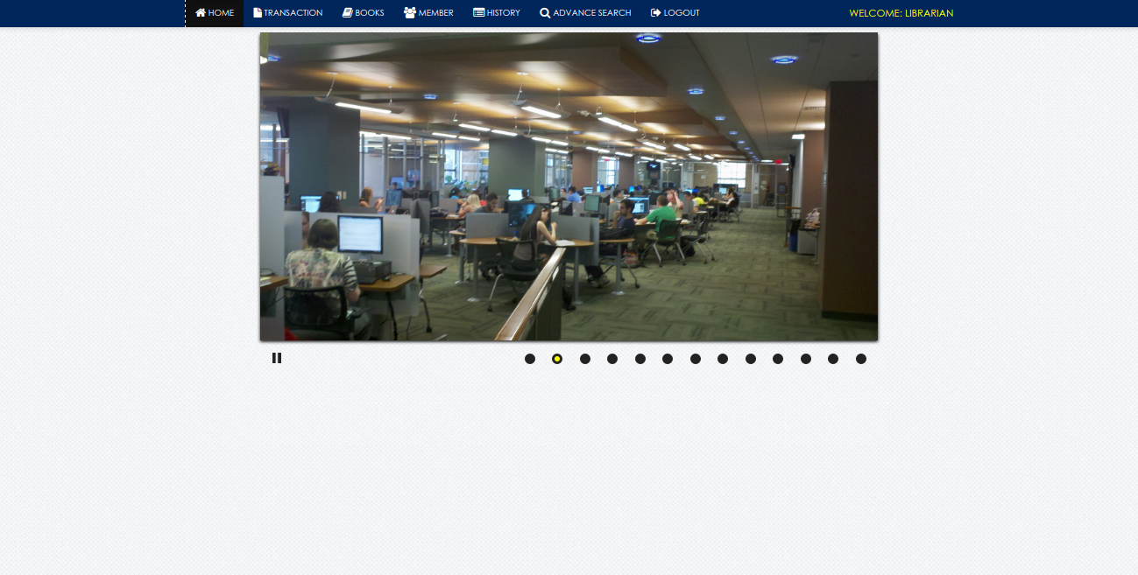

Slide 5
